Slide 1
Women Health Problem Application
BUILDING SOLUTIONS
Group members-
Dopender
Kushal Mathur
Pankaj Sharma
Aman Agarwal
Notes:
We designed this template so that each member of the project team has a set of slides with its own theme. Members, here’s how you add a new slide to just your set:
Mark where you want to add the slide: Select an existing one in the Thumbnails pane, click the New Slide button, then choose a layout. The new slide gets the same theme as the other slides in your set.
Careful! Don’t annoy your fellow presenters by accidentally changing their themes. That can happen if you choose a different theme from the Design tab, which changes all of the slides in the presentation to that look.

Slide 2
Agenda
The advantage of Application
Main Features
Project Description
Need for this project
Description of the project
Data flow diagram
Glimpses of the application
Business approach
Conclusion

Slide 3
The advantage of Application:
Available 24*7
Scalable with lower costs
Improved personalization
Ideal for a repetitive and transactional use case with a testable result ( appointment ).

Slide 4
Main Features:
1. Revamped doctor listings. 2. Slicker and better layout. 3. Everything you need in order to be healthier and happier.

Slide 5
Need of the project And Hypothesis
Objective And Hypothesis
To understand and solve the problem of women health by the aid of artificial intelligence and machine learning .
All women know how to operate a smartphone.
Women should know how to read and write their first language.
Access to the internet.

Slide 6
Description of the Solution
This is a AI based multilingual chatbot application which will deal with the healthcare of the women's and rate provide the solution set if can be provided.
It will deal with all kinds of diversified problems of the women's healthcare.
It will also have facility to engage with Doctors if the user feels to consult with them.
There will also be a gender neutral community that will promote the taboo topics to normal in the society.

Slide 7
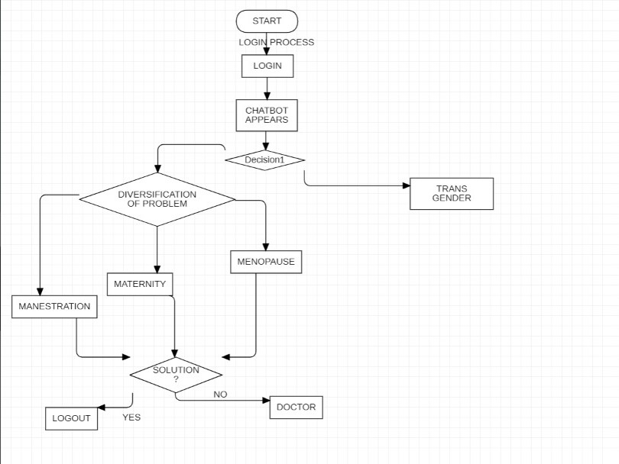
Data Flow Diagram

Slide 8
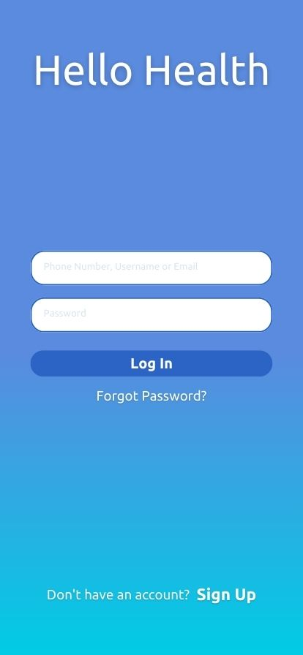
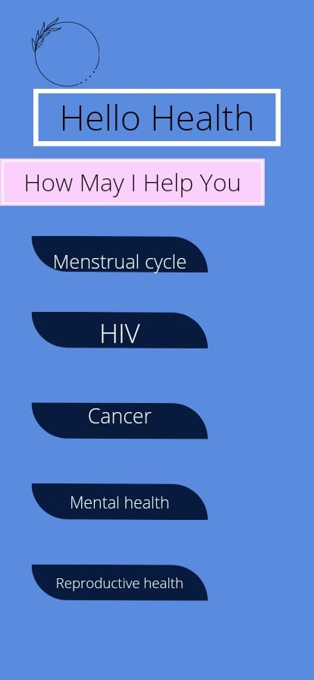
Glimpses of the application

Slide 9
Business Approach
subscription base modal
Individual module access
Tie –up with Doctors

Slide 10


Conclusion
Women represent the cornerstone of a family's overall health, ensuring they have access to quality care also can lead to improved health for children and families. The health of families and communities are no doubt, tied to the health of women.

